Slide 1
ENT emergency
Dr . Fatima alzahraa haj oubid
Damascus hospital

Slide 2
Management of Emergent Airway
Epistaxis
Auricular Hematoma
ENT Foreign bodies
trauma facial cervical

Slide 3
Causes of a Difficult Airway
Trauma
( Midface , Mandible , Neck )
Bleeding into airway
Caustic ingestion
Thermal burns
Foreign Body
inflammation infection
Deep Neck Space Abscess
Ludwig’s angina

Slide 4
Causes of a Difficult Airway
Trismus
Anaphylaxis
Angioedema
Previous head and neck surgery
Vocal cord paralysis
Macroglossia
Anatomic/congenital factors

Slide 5
LEMON Airway Assessment
Look
Evaluate
Mallampati classification
Obstruction
Neck mobility

Slide 6
Our Aim
Maintain patent airway
Secure airway
Prevent aspiration
Adequate and effective ventilation
Further resuscitation

Slide 7
Clear the Airway
Clear the airway – oropharyngeal cavity of:
Any secretions
Any blood
Vomitus
Loose dentures
Any foreign body obstructing the airway

Slide 8
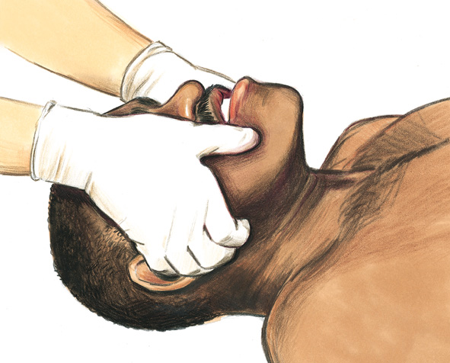
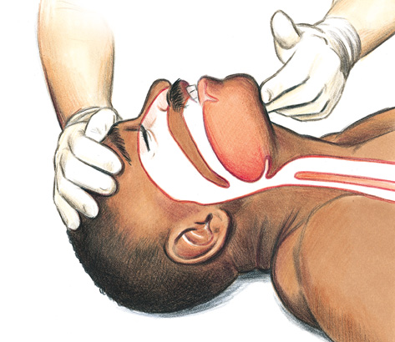
Open the Airway
Jaw thrust
Head tilt–chin lift

Slide 9
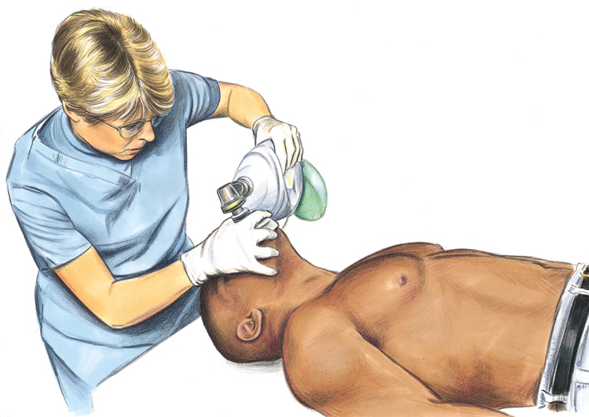
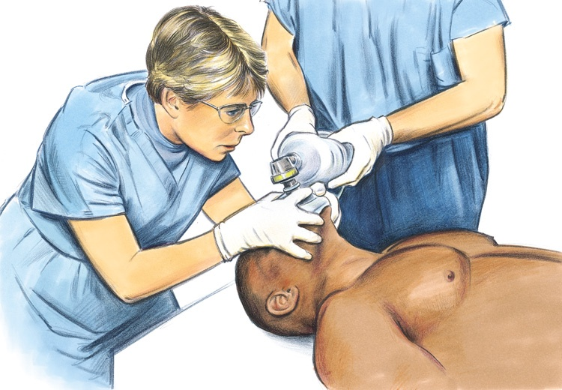
Bag Mask Ventilation
Key—ventilation volume: “enough to produce obvious chest rise”
1-Person difficult, less effective
2-Person easier, more effective

Slide 10
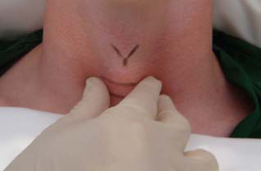
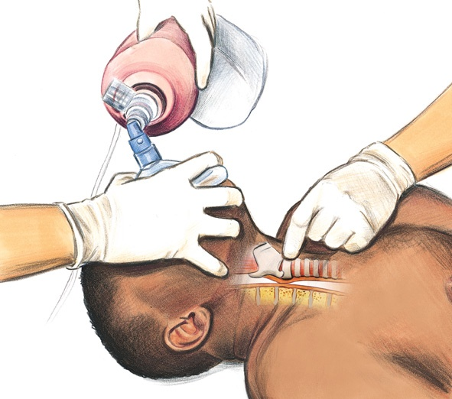
Bag Mask Ventilation
Sellick’s Maneuver
Cricoid Pressure – to prevent regurgitation and aspiration

Slide 11
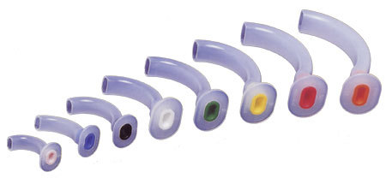
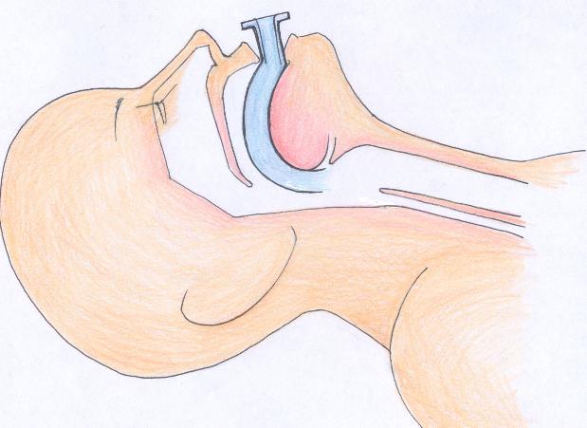
Oropharyngeal Airway

Slide 12
Nasopharyngeal Airway

Slide 13
Endotracheal Intubation
Endotracheal tube is passed into trachea of patient through oral or nasal route to ensure the patent airway and adequate ventilation
Achieves all the goals of airway management
Rapid, Simple, Safe and Non-surgical
Maintains patent airway
Protect lungs from aspiration
Leak free ventilation
Remains GOLD STANDARD of airway management

Slide 14
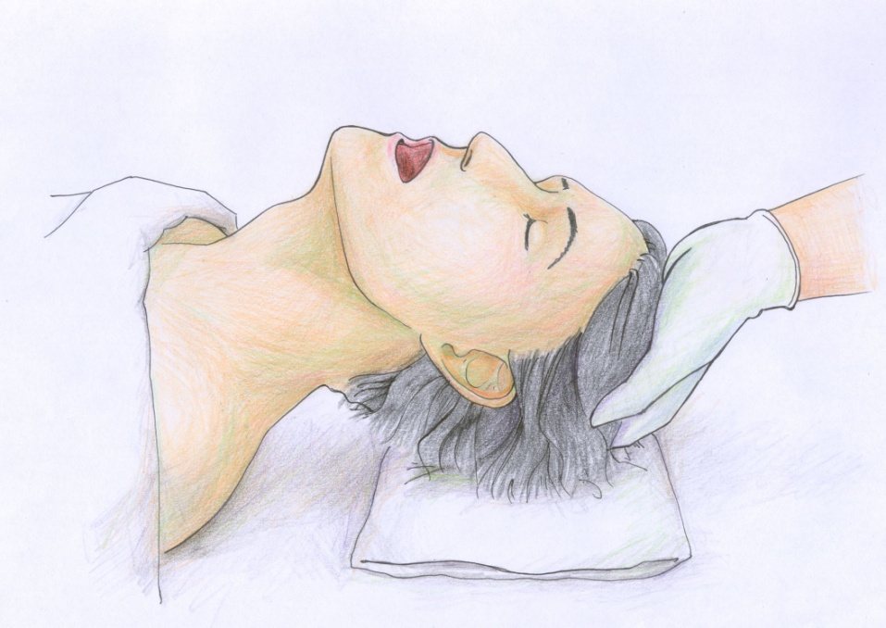
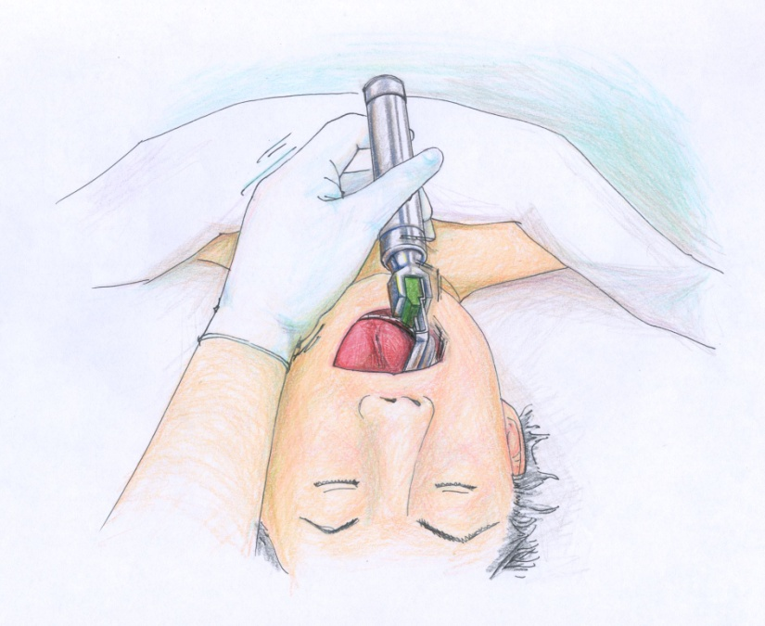
Insertion

Slide 15
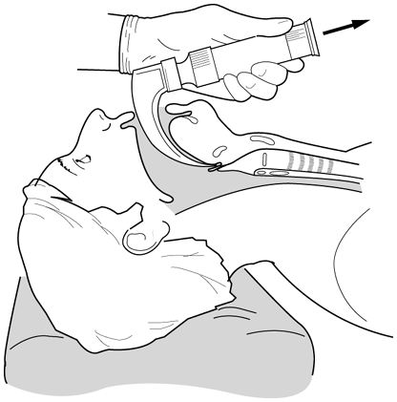
Insertion

Slide 16
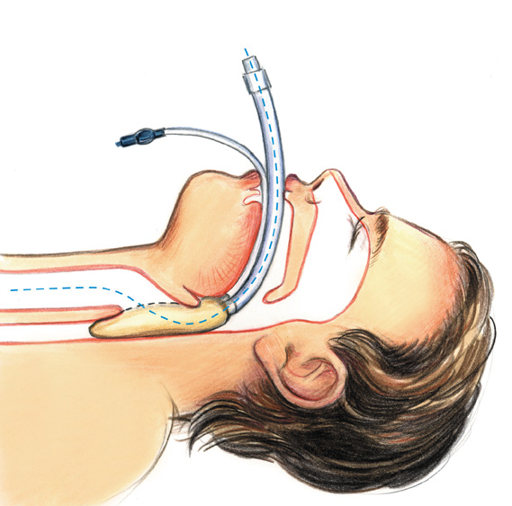
Laryngeal Mask Airway

Slide 17
Procedure

Slide 21
Blunt Neck Trauma and Laryngotracheal Injury
Strangulation
Cervical Spine Injuries in BNT
Vascular Injuries in BNT
Penetrating neck injuries

Slide 23
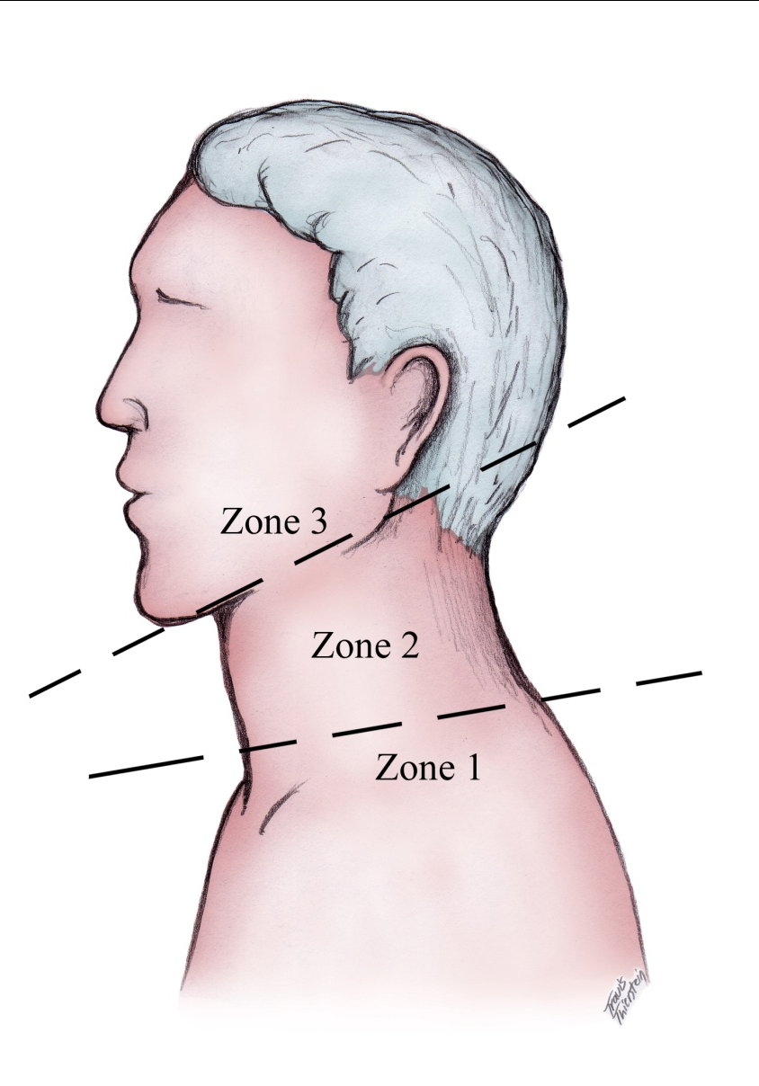
Zones of the Neck
This actually applies to penetrating trauma but is useful to review when discussing neck anatomy.
Zone I: thoracic inlet to cricoid cartilage
Zone II: cricoid cartilage to the angle of mandible
Zone III: angle of the mandible to skull base to

Slide 24
Anatomy: Facial planes
Hematomas, air tracks
Bullet, metal tracks
Carotid space: Carotid, IJV, CN X
Retropharyngeal space: behind pharynx, anterior to prevertebral muscles
Perivertebral space: muscles & soft tissue around vertebrae
Bleeding that displaces prevertebral muscles anteriorly is associated with vertebral body fractures.
Retropharyngeal carotid artery important for presurgical planning
Esophageal injury can track air into RP, prevertebral space
Missed esophageal injuries can present as retropharyngeal abscess, mediastinitis, sepsis
www.medscape.com
Notes:
Bleeding that displaces prevertebral muscles anteriorly is associated with vertebral body fractures.
Retropharyngeal carotid artery important for presurgical planning
Esophageal injury can track air into RP, prevertebral space
Missed esophageal injuries can present as retropharyngeal abscess, mediastinitis, sepsis

Slide 25
Morbidity: Vascular injury
Major Signs
Active bleeding
Unstable/hypotension
Expanding hematoma
Pulsatile swelling
Bruit, thrill
Unilateral CNS deficit
Pulse deficit
Minor Signs
Parasthesias
Nonexpanding hematoma
C spine or skull base fractures in MVAs

Slide 26
Morbidity: Esophageal Injury
Odynophagia, dysphagia, hematemesis
Airway injury → 25% have esophageal injury
Transcervical trajectory
Saliva in wound, subcutaneous emphysema
Prevertebral air on lateral neck X ray
Kietdumrongwong P & Hemachudha T 2005
Kietdumrongwong P & Hemachudha T. Pneumomediastinum as initial presentation of paralytic rabies: A case reportBMC Infectious Diseases 2005, 5:92.
Notes:
Kietdumrongwong P & Hemachudha T. Pneumomediastinum as initial presentation of paralytic rabies: A case reportBMC Infectious Diseases 2005, 5:92.

Slide 27
Morbidity: Airway Injury
More common in blunt trauma
5-15% PNI will have laryngotracheal trauma
Hoarseness, stridor, hemoptysis, difficulty breathing, pain
Air leak in wound, difficult airway → surgery!!!
Majority airways managed by rapid sequence intubation (RSI) at scene or ED
Mandavia DP 2000 | Retrospective | N = 748 | 11% emergent intubation -67% RSI with → 100% success -33% fiberoptic → 91% success -3 fiberoptic failures → RSI
Eggen JT 1993 |  | N = 114 | 60% intubated, 22% ED No intubation complications
Shearer VE 1993 |  | N = 107 | 83% RSI with DL → 100% success 6% surgical airway → 100% 7% awake fiberoptic→ 98% 4% blind nasotracheal →75%
Eggen JT et al. Airway management, penetrating neck trauma. J Emerg Med 1993: 11: 31-5.
Mandavia DP et al. Emergency airway management in penetrating neck injury. Ann Emerg Med 2000; 35: 221-5.
Shearer VE et al. Airway management for patients with penetrating neck trauma: a retrospective study. Anasth Analg 1993; 77: 1135-8.
Mandavia et al
Shearer et al
Notes:
Eggen JT et al. Airway management, penetrating neck trauma. J Emerg Med 1993: 11: 31-5.
Mandavia DP et al. Emergency airway management in penetrating neck injury. Ann Emerg Med 2000; 35: 221-5.
Shearer VE et al. Airway management for patients with penetrating neck trauma: a retrospective study. Anasth Analg 1993; 77: 1135-8.
Mandavia et al
Shearer et al

Slide 28
Morbidity: Airway Injury
Baisakhiya N et al 2009
Baisakhiya N et al. Laryngotracheal Trauma . The Internet Journal of Otorhinolaryngology. 2009 Volume 9 Number 1
CT shows right thyroid cartilage fracture & air escape suggesting tracheal tear. Extensive subQ air.
Patient managed with tracheostomy, reduction of fracture + fixation with 4-0 prolene. Tracheal partially excised with primary repair of trachea.
Notes:
Baisakhiya N et al. Laryngotracheal Trauma . The Internet Journal of Otorhinolaryngology. 2009 Volume 9 Number 1
CT shows right thyroid cartilage fracture & air escape suggesting tracheal tear. Extensive subQ air.
Patient managed with tracheostomy, reduction of fracture + fixation with 4-0 prolene. Tracheal partially excised with primary repair of trachea.

Slide 29
Auricular Hematoma
accumulation of blood in the subperichondrial space, secondary to blunt trauma .
This creates a barrier for diffusion between the cartilage and the perichondrial vascularity, leading to necrosis of the cartilage .

Slide 30
Auricular Hematoma

Slide 31
Nasal trauma
Nasal fracture is the most common of head and neck fractures .
the amount of force required to create a fracture of the nasal structure is small, possibly as little as 25 pounds of pressure .

Slide 32
Nasal trauma
Evaluation :
New deformity of the nose , often with epistaxis.
Facial swelling and black eyes .
X ray to exclude other bony facial fracture ,
And to document nasal fracture .
Looking for septal hematoma .

Slide 33
Nasal trauma
Timing of repair :
Within 1 - 3 hours of the time of injury before significant edema has developed .
However, patients rarely present this early and often require reevaluation within 3 -7 days to allow for extensive facial edema to subside.

Slide 34
Nasal trauma
Anesthesia
Local :
for adults , cooperative patient .
General :
For children , uncoopetrative patient .
Reduction
Closed : safe , easy and reasonable cosmetic and functional results .
Open :usually reserved for cases in which either a prior closed reduction has failed or malunion has occurred .

Slide 35
epistaxis
common problem , affects most of us at sometimes .
It is usually mild and self-limiting .
The anterior part ( little area ) of the nasal septum is the most frequent site for bleeding , because of rich blood supply .

Slide 36
Anatomy

Slide 37
Causes of epistaxis
Local causes :
Nose picking .
Trauma .
Infection .
Tumor .
Idiopathic .
Systemic causes :
Hypertension .
Anti coagulant drug .
NSAIDs .
Coagulopathy ( haemophilia , leukaemia ).
Hereditary haemorrhagic telangiectasia .

Slide 38
treatment
First aid :
Lean forward .
Pinch the fleshy part of the nose for 10 minutes .
Put an icepack on the nasal bridge .
Suck an ice cube .
Assess blood loss .
Take the pulse and blood presure .
Gain intravenous access .

Slide 39
treatment

Slide 40
Anterior nasal packing

Slide 41
posterior nasal packing

Slide 42
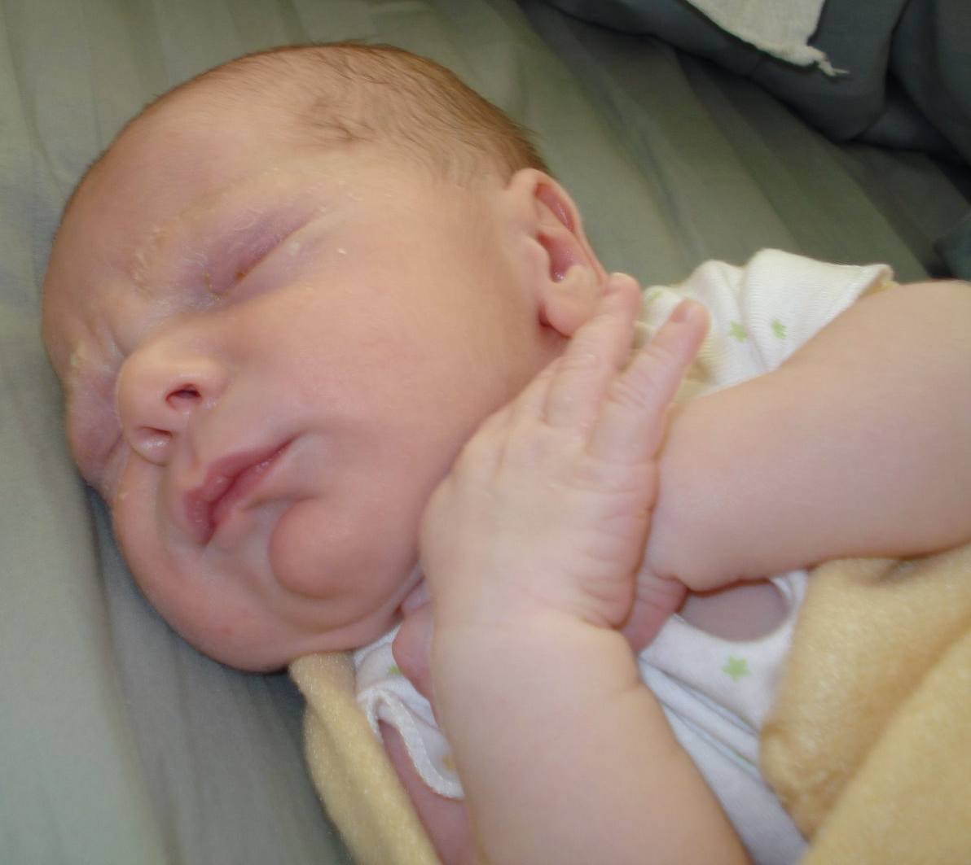
Foreign Body Aspiration

Slide 43
Aspiration in young children
Lack of molar teeth
Poorer mastication
Tendency to put things in mouth
Playing with things in mouth
Immature protective laryngeal reflexes

Slide 44
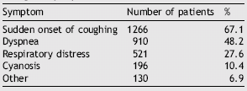
Symptoms and Physical findings
Cough
Dyspnea
Wheezing
Stridor
Cyanosis
Decreased breath sounds
Tachypnea
Rhonchi
Somnolence

Slide 45
ENT Foreign bodies
Signs Foreign bodies in the ear :
Pain .
deafness .
unilateral discharge .
deafness .

Slide 46
ENT Foreign bodies
Signs Foreign bodies in the nose
Unilateral foul smelling discharge .
Unilateral nasal obstruction .
Epistaxis .

Slide 47
ENT Foreign bodies
Signs Foreign bodies in the throat :
Acute onset of symptoms
Drooling
Dysphagia tenderness in the neck .
Pricking sensation on every swallow .

Slide 48
management
Insects may be drowned with olive oil .
Pull foreign bodies by suction .
Grasping with crocodile forceps .
Refer to general anesethea if :
Failed attempt .
Uncooperative child .
Suspected trauma to the drum .

Slide 49
Pull foreign bodies by suction

Slide 50
right-angled hook is passed beyond the object

Slide 51
Peritonsillar Abscess ( quinsy )
bacterial infection can extend beyond the tonsillar capsule .
The abscess lies in the space between the tonsillar capsule and the pharyngeal muscle .

Slide 52
Peritonsillar Abscess ( quinsy )
Signs and symptoms :
Sore tthroat .
Pyrexia .
Trismus .
Drooling .
Fetor .
Peritonsillar swelling .
Displacement of the uvula away from the affected side .

Slide 53
Peritonsillar Abscess ( quinsy )

Slide 54
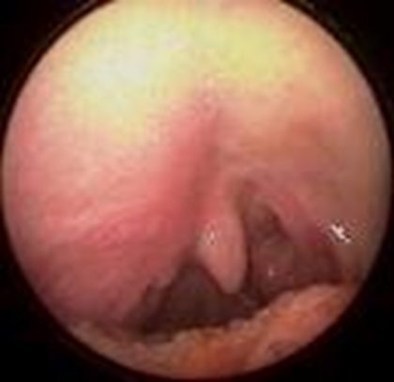

Slide 55
Peritonsillar Abscess ( quinsy )
Treatment :
Admission of the patient .
Re – hydration .
Aspiration and send pus for culture .
Incision .
IV antibiotic .

Slide 57
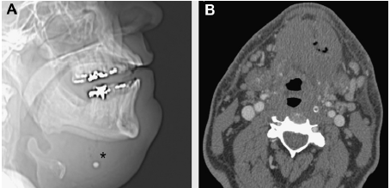
Ludwigs Angina (16)

Slide 58
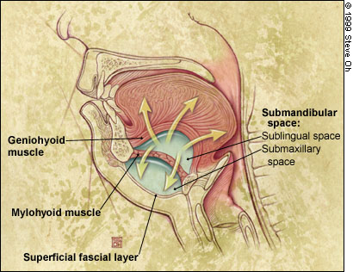
Ludwigs Angina (8)

Slide 59
Epiglottitis
Essentials of Diagnosis :
Rapid progression of symptoms.
Severe odynophagia with drooling .
Irritability, fever, toxicity .
Stridor

Slide 60
Epiglottitis
cellulitis involves multiple areas of the supraglottis .
presents in children between the ages of 2 and 6 years .
Haemophilus influenzae type B (HIB) is the responsible pathogen in most cases .

Slide 61
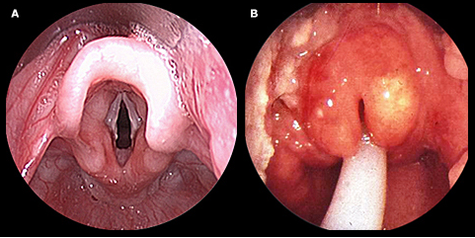
http://1.bp.blogspot.com/_Fd2Fryp9wz0/TQg84FXXtSI/AAAAAAAABlE/h0gnkg2r09U/s1600/Acute_epiglottitis.jpg

Slide 62
Epiglottitis
lateral neck x-ray :
"thumb print" sign .

Slide 63
Epiglottitis
flexible fiberoptic laryngoscopy :
Redden and swollen epiglottic

Slide 64
Epiglottitis
Treatment :
The airway is secured by endotracheal intubation or by tracheostomy .
Parenteral antibiotic therapy (ceftriaxone or cefotaxime )
extubation is often possible after 48–72 hours .

Slide 65
Laryngotracheobronchitis (Croup)
Essentials of Diagnosis :
Gradual onset of symptoms.
Barking cough.
Stridor

Slide 66
Laryngotracheobronchitis (Croup)
the most common infectious cause of airway obstruction in children .
usually occurring between the ages of 6 months and 3 years .
It is a viral infection most commonly caused by the parainfluenza virus .

Slide 67
Laryngotracheobronchitis (Croup)
Evaluation :
x-rays of the neck and chest :
subglottis may be narrowed .

Slide 68
Laryngotracheobronchitis (Croup)
Treatment :
nebulized racemic epinephrine .
nebulized and systemic steroids .
Rarely endotracheal intubation .

Slide 69
Sudden onset hearing loss
Pathogenesis :
Central nervous accident
Autoimmune ( vasculitis ) .
Trauma .
Drugs ( amino glycosides ).

Slide 70
Sudden onset hearing loss
Evaluation :
Full history and examination
ESR and auto antibodies ( immune cause ) .
MRI (CNS system ).
Audiogram to confirm hearing loss .

Slide 71
Sudden onset hearing loss
Treatment :
Admission for bed rest .
Oral steroids .
Acyclovir .
Carbogen gas ( mixture of co2 and o2
5 min per hour )
Daily audiogram .

Slide 72
Facial nerve palsy
Upper motor neurone palsy :
Usually as part of a stroke .
Forehead spared .
Look for other neurological signs .

Slide 73
Facial nerve palsy
Lower motor neurone palsy :
The entire face is affected including forehead .
Taste disturbance .

Slide 74
Facial nerve palsy
Causes of LMN facial palsy :
Bell palsy .
Ramsay hunt syndrome .
Acute otitis media .
Cholesteatoma .
Acoustic neuroma .
Trauma .
Parotid gland malignancy .

Slide 75
Bell palsy
Probably viral in origin .
You must exclude other causes of LMN palsy .
Treatment :
Prednisolone .
Eye drops , lubricating gel to protect cornea from ulceration .
Prognosis :
Good 80% of patient fully recover .

Slide 76
Bell palsy

Slide 77
Thank you

